Slide 1


We think of the environment
You have chosen a Green Key certified establishment. This means that you are automatically helping to preserve the environment, as we meet Green Key’s stringent environmental and sustainability requirements. We make it easier for you to care for the environment without it diminishing your experience and comfort.

Slide 2

We save on water – not on cleanliness
Water is important to us all. We aim to make it easy for you to use less water without it diminishing your experience and comfort. We have water-saving showers, taps and toilets, so that both you as a guest and we as an establishment save water.

Slide 3
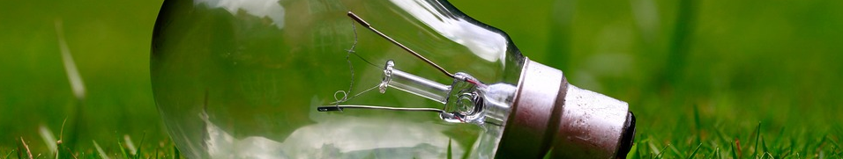
We save on energy – not on lighting
We do not save on lighting, but on energy. We do this by using low-energy lighting, sensors and an intelligent light management system. We make it easy for you to save energy while ensuring that you have cosy, functional lighting.

Slide 4
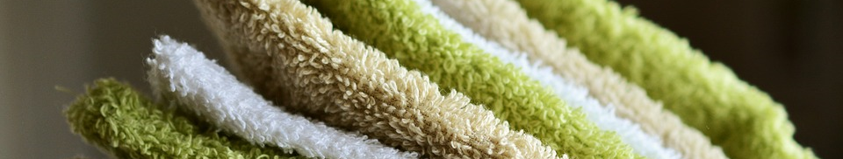
We save on chemicals – not on hygiene
We use environmentally friendly and environmentally labelled cleaning agents, equipment and work methods, so that less chemicals and water are used. We want you to benefit from a better indoor climate with fewer chemicals from cleaning agents while keeping everything clean and nice.

Slide 5

We sort waste
We sort waste into ‘regular’ and ‘environmentally harmful’, so that as much as possible gets recycled and constitutes least harm for the environment. We want to make it easy for you to sort your waste. Please place newspapers, paper, cans, plastic and glass bottles beside the waste bin. Used batteries may be handed in to reception.

Slide 6
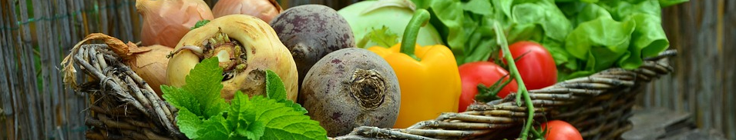
We make environmentally friendly food
We make food in an environmentally friendly way using organic, seasonal, local and free-range products. We want to make it easy for you to care for the environment – also when you eat – while giving you good, intriguing taste experiences.

Slide 7
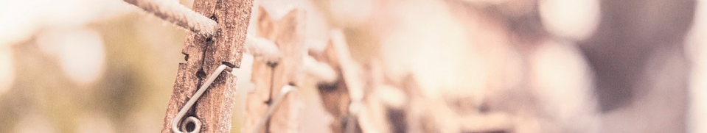
We save on washing – not on hygiene
We use environmentally friendly and environmentally labelled detergents and do not wash clothes, towels and bed linen that have not been used. To save on detergents, packaging, water and energy, we give you the option of using your towels an extra day. Please leave your towel on the floor if you wish to have it changed. We also normally wash your bed linen every third night only, unless you ask us to do it more frequently.

Slide 8
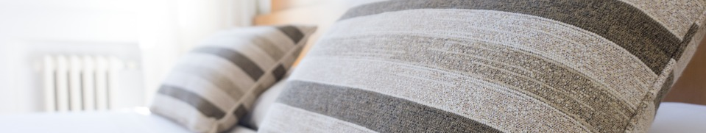
We save on energy – not on heating
We do not save on heating, but on energy. We do so by installing good insulation and low-energy windows, and by using heating and cooling as required. We make it easy for you to save energy while enjoying a comfortable temperature and good indoor climate.

Slide 9
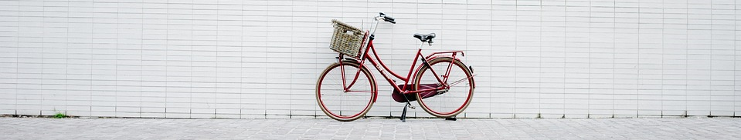
We can tell you about environmentally friendly forms of transport
Bus, train, metro and bicycle are more environmentally friendly forms of transport than cars and taxis. We want to make it easy for you to use environmentally friendly forms of transport. See our website, the information in your room or ask at reception for information about public transport and bicycle rentals.

